Slide 1
Kepler’s Laws of Planetary Motion

Slide 2
Circular!

Slide 3
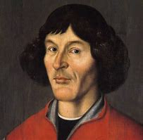
NicolAus Copernicus
German astronomer
First to place the Sun as the center of the solar system
Heliocentric Model
His model was also circular

Slide 4
Tycho Brahe
Danish astronomer
Made many measurements of the position of the planets
BUT he never shared his data!
Employed Kepler (but did not let him see the data)

Slide 5
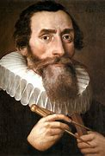
Johannes Kepler
German astronomer
Born in 1571
Studied planetary motion
Studied Tycho’s data when he died, Kepler got access to it

Slide 6
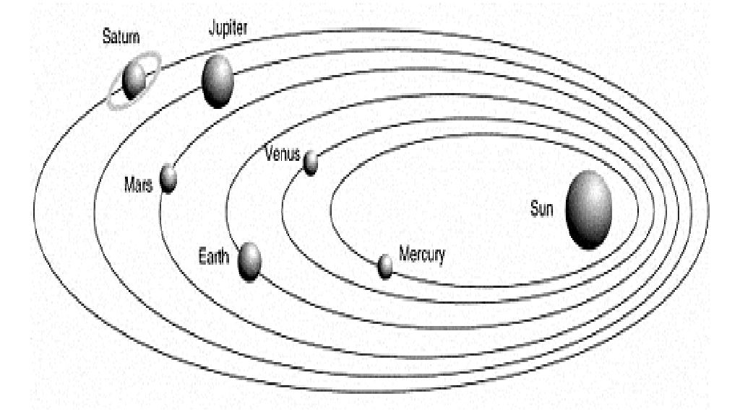
Kepler’s First Law
The orbit of each planet is in an ellipse and the Sun is at one focus
This corrected the current model of the time created by Copernicus

Slide 7
Ellipse
Elongated and flattened circle
Characterized by eccentricity and length of major axis
Eccentricity- degree of flatness
Major axis- longer axis

Slide 8
Focus (plural: Foci)
One of two special points on the major axis of an ellipse
A + B is always the same on any point on the ellipse

Slide 9
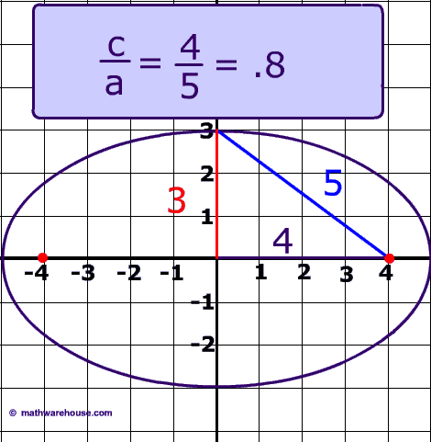
Eccentricity (e)
Degree of flatness
e = 0 for a circle
Earth, e = 0.017
e = c/a
c is center to focus
a is half of major axis (semi-major axis)

Slide 10
Perihelion
The point closest to the Sun
Equal to a distance of a(1-e) from the Sun
Aphelion
The point on the orbit farthest from the Sun
Equal to a distance of a(1+e) from the Sun

Slide 11
Kepler’s Second Law
The line joining the planet to the Sun sweeps out equal areas in equal intervals of time

Slide 12
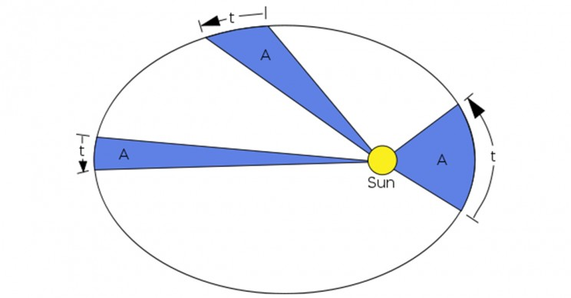
In Other words…
The area from one time to another time is equal to another area with the same time interval

Slide 13
Acceleration of Planets
Planets move faster when closer to the Sun
Force acting on the planet increases as distance decreases and planet accelerates in its orbit
Planets move slower when farther from the Sun

Slide 14
Kepler’s Third Law
The square of the period of any planet is proportional to the cube of the semi-major of its axis
Also referred to as the Harmonic Law

Slide 15
T² = r³
T (P is used for this as well) is the orbital period expressed in years
r (a is used for this as well) is the semi-major axis expressed in astronomical units (AU)
1 AU is the average distance between Earth and the Sun
About 1.5 x 10⁸ km or 9.3 x 10⁷ miles

Slide 17
Comets
Although Kepler’s Laws were intended to describe motion of planets around the sun, they also apply to comets

Slide 18
Kepler’s Three Laws Summarized
Orbit of each planet is in an ellipse and the Sun is at one focus
Equal areas in equal intervals of time
T² = r³

Slide 19
Sir Isaac Newton
Provided explanation for WHY $\frac{r3}{T2}$ was the same for all planets
Kepler could never figure out why this is constant

Slide 21
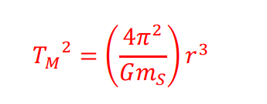
Newton’s Version of Kepler’s 3rd Law
G= Gravitational constant= 6.673⋅10⁻¹¹ $\frac{Nm2}{kg2}$

